Slide 1




Code Documentation
Comments in the Program and Self-Documenting Code
Svetlin Nakov
Technical Trainer
www.nakov.com
Software University
http://softuni.bg

Slide 2

Table of Contents
The Concept of Self-Documenting Code
Bad Comments
Good Programming Style
To Comment or Not to Comment?
Key Points commenting
Recommended practices
C# XML Documentation Comments
JavaDoc

Slide 3

Comments and Code Documentation
The Concept of Self-Documenting Code

Slide 4

What is Project Documentation?
Consists of documents and information
Both inside the source-code and outside
External documentation
At a higher level compared to the code
Problem definition, requirements, architecture, design, project plans, test plans. etc.
Internal documentation
Lower-level – explains a class, method or a piece of code

Slide 5

Programming Style
Main contributor to code-level documentation
The program structure
Straight-forward, easy-to-read and easily understandable code
Good naming approach
Clear layout and formatting
Clear abstractions
Minimized complexity
Loose coupling and strong cohesion

Slide 6

Bad Comments – Example
public static List<int> FindPrimes(int start, int end)
{
// Create new list of integers
List<int> primesList = new List<int>();
// Perform a loop from start to end
for (int num = start; num <= end; num++)
{
// Declare boolean variable, initially true
bool prime = true;
// Perform loop from 2 to sqrt(num)
for (int div = 2; div <= Math.Sqrt(num); div++)
{
// Check if div divides num with no remainder
if (num % div == 0)
{
// We found a divider -> the number is not prime
prime = false;
// Exit from the loop
break;
}
(continues on the next slide)

Slide 7
Bad Comments – Example (2)
// Continue with the next loop value
}
// Check if the number is prime
if (prime)
{
// Add the number to the list of primes
primesList.Add(num);
}
}
// Return the list of primes
return primesList;
}

Slide 8

Self-Documenting Code – Example
public static List<int> FindPrimes(int start, int end)
{
List<int> primesList = new List<int>();
for (int num = start; num <= end; num++)
{
bool isPrime = IsPrime(num);
if (isPrime)
{
primesList.Add(num);
}
}
return primesList;
}
Good code does not need comments. It is self-explaining.
(continues on the next slide)

Slide 9
Self-Documenting Code – Example (2)
Good methods have good names and are easy to read and understand.
private static bool IsPrime(int num)
{
bool isPrime = true;
int maxDivider = Math.Sqrt(num);
for (int div = 2; div <= maxDivider; div++)
{
if (num % div == 0)
{
// We found a divider -> the number is not prime
isPrime = false;
break;
}
}
return isPrime;
}
This comment explain non-obvious details. It does not repeat the code.

Slide 10
Bad Programming Style – Example
for (i = 1; i <= num; i++)
{
meetsCriteria[i] = true;
}
for (i = 2; i <= num / 2; i++)
{
j = i + i;
while (j <= num)
{
meetsCriteria[j] = false;
j = j + i;
}
}
for (i = 1; i <= num; i++)
{
if (meetsCriteria[i])
{
Console.WriteLine(i + " meets criteria.");
}
}
Uninformative variable names. Crude layout.

Slide 11
Good Programming Style – Example
for (primeCandidate = 1; primeCandidate <= num; primeCandidate++)
{
isPrime[primeCandidate] = true;
}
for (int factor = 2; factor < (num / 2); factor++)
{
int factorableNumber = factor + factor;
while (factorableNumber <= num)
{
isPrime[factorableNumber] = false;
factorableNumber = factorableNumber + factor;
}
}
for (primeCandidate = 1; primeCandidate <= num; primeCandidate++)
{
if (isPrime[primeCandidate])
{
Console.WriteLine(primeCandidate + " is prime.");
}
}

Slide 12
Self-Documenting Code
Code that relies on good programming style
To carry major part of the information intended for the documentation
Self-documenting code fundamental principles
The best documentation is the code itself.
Make the code self-explainable and self-documenting, easy to read and understand.
Do not document bad code, rewrite it!

Slide 13
Self-Documenting Code Checklist
Classes
Does the class’s interface present a consistent abstraction?
Does the class’s interface make obvious how you should use the class?
Is the class well named and does its name describe its purpose?
Can you treat the class as a black box?
Do you reuse instead of repeating code?

Slide 14
Self-Documenting Code Checklist (2)
Methods
Does each routine’s name describe exactly what the method does?
Does each method perform one well-defined task with minimal dependencies?
Data Names
Are type names descriptive enough to help document data declarations?
Are variables used only for the purpose for which they’re named?

Slide 15
Self-Documenting Code Checklist (3)
Data Names
Does naming conventions distinguish among type names, enumerated types, named constants, local variables, class variables, and global variables?
Others
Are data types simple so that they minimize complexity?
Are related statements grouped together?

Slide 16
To Comment or Not to Comment?
"Everything the Compiler Needs to Know is in the Code!"

Slide 17
Effective Comments
Effective comments do not repeat the code
They explain it at a higher level and reveal non-obvious details
The best software documentation is the source code itself – keep it clean and readable!
Self-documenting code is self-explainable and does not need comments
Simple design, small well named methods, strong cohesion and loose coupling, simple logic, good variable names, good formatting, …

Slide 18
Effective Comments – Mistakes
Misleading comments
// write out the sums 1..n for all n from 1 to num
current = 1;
previous = 0;
sum = 1;
for (int i = 0; i < num; i++)
{
Console.WriteLine("Sum = " + sum);
sum = current + previous;
previous = current;
current = sum;
}
What problem does this algorithm solve?
Can you guess that sum is equal to the i^{th} Fibonacci number?

Slide 19
Effective Comments – Mistakes (2)
Comments repeating the code:
// set product to "base"
product = base;
// loop from 2 to "num"
for ( int i = 2; i <= num; i++ )
{
// multiply "base" by "product"
product = product * base;
}
Console.WriteLine("Product = " + product);
Obviously…
You don’t say…
Notes:
Comment does not add anything to the code

Slide 20

Effective Comments – Mistakes (3)
Poor coding style:
Do not comment bad code, rewrite it!
// compute the square root of Num using
// the Newton-Raphson approximation
r = num / 2;
while (abs(r - (num/r)) > TOLERANCE)
{
r = 0.5 * (r + (num/r) );
}
Console.WriteLine("r = " + r);
Notes:
Comment does not add anything to the code

Slide 21
Key Points for Effective Comments
Use commenting styles that don’t break down or discourage modification
The above comments are unmaintainable
// Variable Meaning
// -------- -------
// xPos .............. X coordinate position (in meters)
// yPos .............. Y coordinate position (in meters)
// zPos .............. Z coordinate position (in meters)
// radius ............ The radius of the sphere where the
battle ship is located (in meters)
// distance .......... The distance from the start position
(in meters)

Slide 22
Key Points for Effective Comments (2)
Comment the code intent, not implementation details
// Scan char by char to find the command-word terminator ($)
done = false;
maxLen = inputString.length;
i = 0;
while (!done && (i < maxLen))
{
if (inputString[i] == "$")
{
done = true;
}
else
{
i++;
}
}

Slide 23
Key Points for Effective Comments (3)
Focus your documentation efforts on the code
// Find the command-word terminator
foundTheTerminator = false;
maxCommandLength = inputString.length;
testCharPosition = 0;
while (!foundTheTerminator &&
(testCharPosition < maxCommandLength))
{
if (inputString[testCharPosition] == COMMAND_WORD_TERMINATOR)
{
foundTheTerminator = true;
terminatorPosition = testCharPosition;
}
else
{
testCharPosition = testCharPosition + 1;
}
}
Better code → less comments

Slide 24
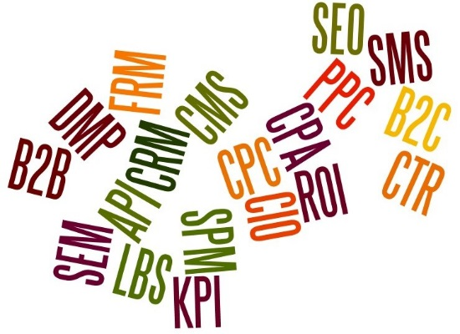

Key Points for Effective Comments (4)
Focus paragraph comments on the why rather than the how
Use comments to prepare the reader for what is to follow
Avoid abbreviations
// Establish a new account
if (accountType == AccountType.NewAccount)
{
…
}

Slide 25
Guidelines for Effective Comments (5)
Comment anything that gets around an error or an undocumented feature
E.g. // This is a workaround for bug #3712
Justify violations of good programming style
Use built-in features for commenting
Don’t comment tricky code – rewrite it
Write documentation using tools
XML comments in C#
JavaDoc in Java, …

Slide 26
Guidelines for Higher Level Documentation
Describe the design approach to the class
Describe limitations, usage assumptions, and so on
Comment the class interface (public methods / properties / events / constructors)
Don’t document implementation details in the class interface
Describe the purpose and contents of each file
Give the file a name related to its contents

Slide 27

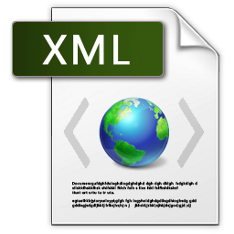
C# XML Documentation

Slide 28
C# XML Documentation
In C# you can document the code by XML tags in special comments
Directly in the source code
For example:
The XML doc comments are not metadata
Not included in the compiled assembly
/// <summary>
/// This class performs an important function.
/// </summary>
public class MyClass { }

Slide 29
XML Documentation Tags
<summary>
A summary of the class / method / object
<param>
Describes one of the parameters for a method
<returns>
A description of the returned value
<remarks>
Additional information (remarks)
<param name="name">description</param>

Slide 30
XML Documentation Tags (2)
<c> and <code>
Gives you a way to indicate code
<see> and <seealso> and cref
Code reference
<exception>
Lets you specify which exceptions can be thrown
All tags: http://msdn.microsoft.com/en-us/library/5ast78ax.aspx
<seealso cref="TestClass.Main"/>
<exception cref="type">description</exception>

Slide 31
XML Documentation Example
/// <summary>
/// The GetZero method. Always returns zero.
/// </summary>
/// <example>
/// This sample shows how to call the <see cref="GetZero"/> method.
/// <code>
/// class TestClass
/// {
/// static int Main()
/// {
/// return GetZero();
/// }
/// }
/// </code>
/// </example>
public static int GetZero()
{
return 0;
}

Slide 32
C# XML Documentation
Visual Studio will use the XML documentation for autocomplete
Automatically, just use XML docs
Compiling the XML documentation:
Compile with /doc the code to extract the XML doc into an external XML file
Use Sandcastle or other tool to generate CHM / PDF / HTML / other MSDN-style documentation
Example: http://www.ewoodruff.us/shfbdocs/

Slide 33

Demo: C# XML Documentation

Slide 34

JavaDoc Documentation

Slide 35
JavaDoc Documentation
In Java you can document the code using the built-in JavaDoc tool
JavaDoc tags are preceded by @ "at"
You can use HTML tags in the documentation code
For example:
/**
* This method returns the sum of two numbers
* @param num1 The first number to sum
* @param num2 The second number to sum
* @return The sum of the two numbers
*/
public static int SumTwoNumbers(int num1, int num2) {
}

Slide 36
JavaDoc Documentation Tags
The summary is exactly after the opening "/**" JavaDoc comment
Some JavaDoc Tags:
@param - method parameter
@author - author of the class
@return - method return value
@throws/@exception - exceptions that method throws
{@code } - source code
@see - reference to other class similar to this

Slide 37
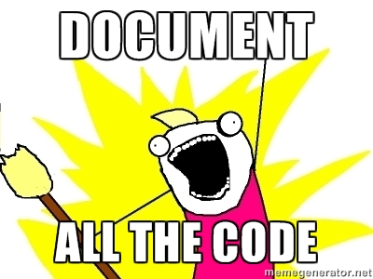
JS and PHP Documentation

Slide 38
JS and PHP Documentation
JavaScript and PHP does not have official tools for code documentation. The following apps are widely used.
JavaScript - YUIdoc - Creates API documentation from source code
Official site - http://yui.github.io/yuidoc/
Tutorial - http://code.tutsplus.com/tutorials/...
PHP - PHPDocumenotor
Official site - http://www.phpdoc.org/
Both use documentation very similar to JavaDoc

Slide 39
Code Documentation
http://softuni.bg/courses/high-quality-code/

Slide 40

License
This course (slides, examples, demos, videos, homework, etc.) is licensed under the "Creative Commons Attribution-NonCommercial-ShareAlike 4.0 International" license
Attribution: this work may contain portions from
"High Quality Code" course by Telerik Academy under CC-BY-NC-SA license

Slide 41







SoftUni Diamond Partners

Slide 42





Free Trainings @ Software University
Software University Foundation – softuni.org
Software University – High-Quality Education, Profession and Job for Software Developers
softuni.bg
Software University @ Facebook
facebook.com/SoftwareUniversity
Software University @ YouTube
youtube.com/SoftwareUniversity
Software University Forums – forum.softuni.bg

